Slide 1
Engaging Fathers through the Strengthening Families Framework
Sallye Longshore, Director
Alabama Department of Child Abuse & Neglect Prevention
Children’s Trust Fund
Prevent Child Abuse Alabama

Slide 2
OVERVIEW
Alabama Department of Child Abuse & Neglect Prevention, The Children’s Trust Fund, was established in 1983
We became the Prevent Child Abuse Alabama Chapter in 2007
Our Mission:
We secure resources to fund evidenced-based community programs committed to the prevention of child maltreatment. We advocate for children and the strengthening of families.

Slide 3
GRANTEE NETWORK
We currently provide 146 community-based prevention grants:
18 Home Visiting Programs
14 Mentoring Programs
43 Parent Education & Support Programs
15 Public Awareness & Training Programs
7 Respite Care Programs
27 School-Based & After School Programs
22 Fatherhood Programs

Slide 4
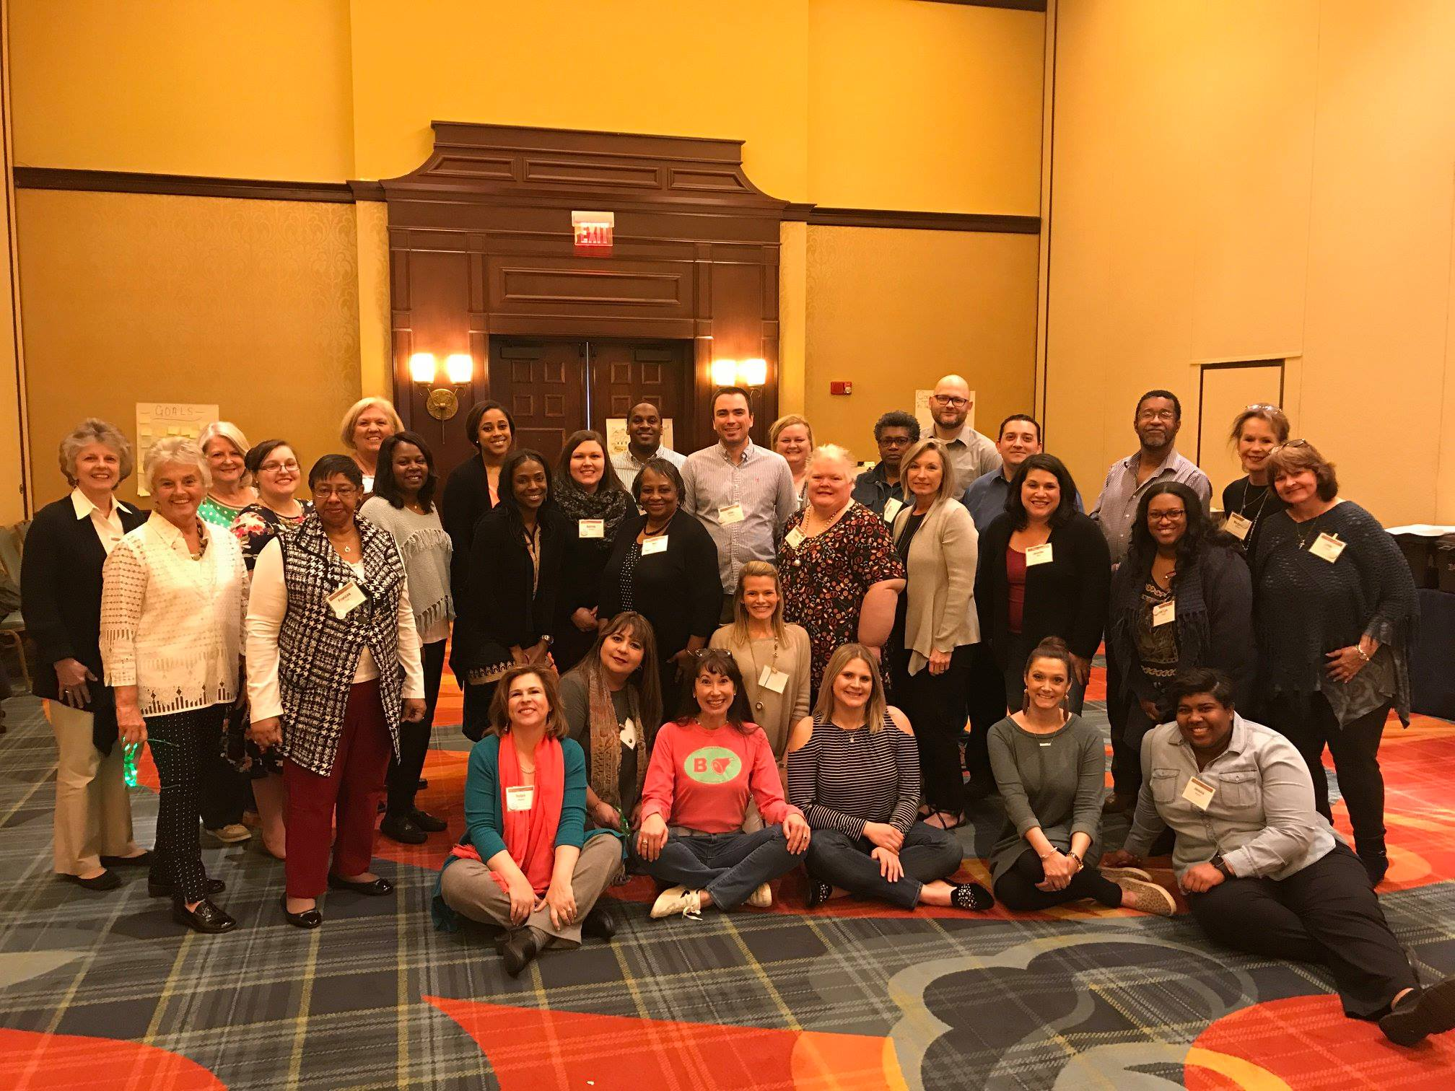
NETWORK OF FAMILY RESOURCE CENTERS
In 2018, we sponsored the National Alliance’s training to certify our Department’s staff along with staff of each Family Resource Center in our state
This increased the number of certified trainers in Alabama from 3 to 33

Slide 5
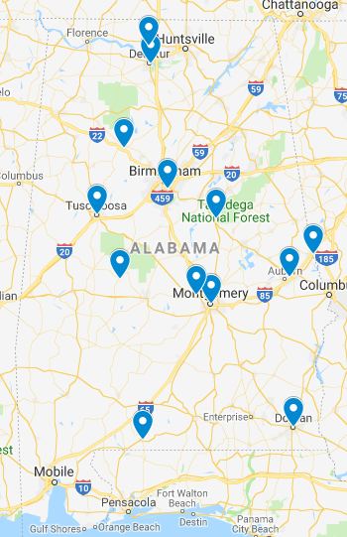
NETWORK OF FAMILY RESOURCE CENTERS
Provides a regional approach to expanding and embedding the framework statewide
Monthly calls with all certified trainers provides consistent communication to support one another’s outreach and training efforts

Slide 6
STRENGTHENING FAMILIES THROUGH FATHERS
Through funding from DHR, we launched the Strengthening Families through Fathers pilot program in three regions of the state
Involves fathers (and mothers) who are involved in SNAP, child care subsidy program, and child support cases as participants in free program to gain education and employment services, while also training them in the protective factors framework

Slide 7
Why Engage Fathers?
Non-residential fathers may play a role in ameliorating the circumstances that led to abuse
Non-resident fathers’ involvement with their children increases chances of reunification
Children with highly-involved non-resident fathers are discharged from foster care more quickly than those whose fathers have less or no involvement
For children who are reunited with a parent, higher levels of non-resident father involvement lower the likelihood of subsequent maltreatment allegations

Slide 8
Evaluation results of DHR funded Fatherhood programs with CTF
Assessment of 14 targeted outcomes with approximately 1,850 participants revealed statistically significant improvements in:
Commitment to couple relationship stability
Conflict management skills
Communication skills
Co-parenting conflict
Dating abuse prevention skills
Hopeful about future

Slide 9
Evaluation results of DHR funded Fatherhood programs with CTF
(Continued)
Assessment of 14 targeted outcomes with approximately 1,850 participants revealed statistically significant improvements in:
Financial responsibility
Perception of economic stability
Cooperation with child support personnel
Commitment to pay full child support
Positive parenting behavior
Parent involvement
Parent child relationship quality
Child academic adjustment

Slide 12
CONTACT
Sallye Longshore, Director
Sallye.Longshore@ctf.alabama.gov
www.ctf.alabama.gov

