Slide 1
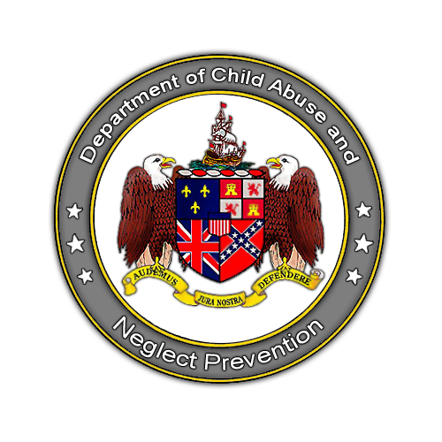
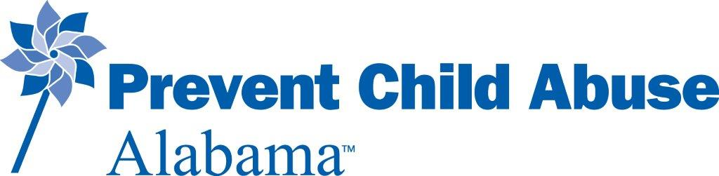
State of Alabama
Department of Child Abuse and Neglect Prevention
Moving from Mandatory Reporting to Mandatory Supporting: Keeping Students Safe
MEGA 2023

Slide 2
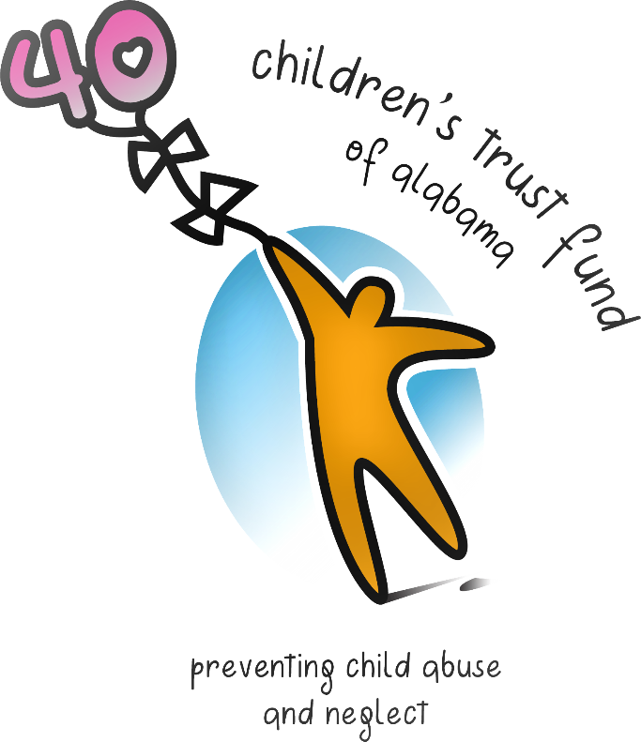
Department of Child Abuse & Neglect Prevention
Created by Act of Legislature in 1983
Community-Based Prevention Programs
Public Policy Advocacy
Public Education
Network of Grantees
Affiliated with National Organizations
  Children’s Trust Fund Alliance
  Prevent Child Abuse America

Slide 3
Who is a Mandatory Reporter?
Any person whose profession brings them in contact with children on a daily basis is legally obligated to report signs of suspected child abuse or neglect.
Employees at hospitals, clinics and sanitariums
Social Workers
Child Care Employees
Clergy
School Teachers/Officials
Dentists
Law Enforcement
Peace Officers
Mental Health Professionals
Pharmacists
Nurses
Podiatrists
Chiropractors
Optometrists
Osteopaths
Coroners
Medical Examiners
Surgeons
Physician
Doctors

Slide 4
Added to Mandatory Reporter Law
Physical Therapists
Public and private K-12 Employees
Employees of public and private institutions of postsecondary and higher education
Notes:
Updated for the current law.

Slide 5
Other Changes to Mandatory Reporter Law
The statement “or cause reports to be made of the same” has been eliminated from the law.
It is the responsibility of the mandatory reporter to make the report and follow up with a written report to the county DHR.
Notes:
Updated for the current law.

Slide 6
What is Child Abuse?
Harm or threatened harm to a child’s health or welfare which can occur through non-accidental physical or mental injury, sexual abuse or attempted sexual abuse, sexual exploitation or attempted sexual exploitation.

Slide 7
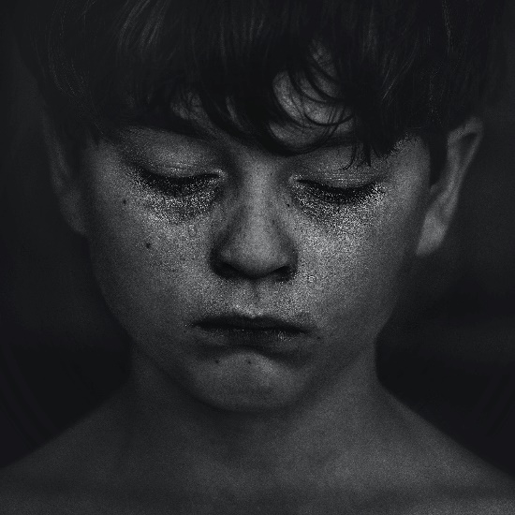
Different Types of Child Abuse
Physical
Sexual
Emotional
Neglect/ Failure to thrive

Slide 8
Physical Abuse
Abuse means harm or threatened harm to the health or welfare of a child through:
Non-accidental physical injury
Sexual abuse or attempted sexual abuse
Sexual exploitation or attempted sexual exploitation
Hitting
Kicking
Biting
Burning
Pushing
Shaking
Any other physical act that can cause injury to a child
Citation: Ala. Code § 26-14-1(1)

Slide 9
Signs to Look for with Physical Abuse
Bruises
Marks in the shape of an object
Unexplained bruises, burns or cuts
Fear of adults
Destructiveness toward self or others
Poor social skills
Aggression
Defiance
Clothing that may be inappropriate

Slide 10
Sexual Abuse
Sexual abuse includes:
  The employment, use, persuasion, inducement, enticement, or coercion of any child to engage in or having a child assist any other person to engage in any sexually explicit conduct
  Any simulation of the conduct for the purpose of producing any visual depiction of the conduct
  The rape, molestation, prostitution, or other form of sexual exploitation of children
  Incest with children
Citation: Ala. Code § 26-14-1(1)
Sexual exploitation includes:
  Allowing, permitting, or encouraging a child to engage in prostitution
  Allowing, permitting, encouraging, or engaging in the obscene or pornographic photographing, filming, or depicting of a child for commercial purposes
Citation: Ala. Code § 26-14-1(1)

Slide 11
Signs to Look for with Sexual Abuse
Inappropriate displays of affection
Unusual interest in or inappropriate sexual knowledge
Over-compliance
Pain during urination
Difficulty walking or sitting
Frequent vomiting
Wetting pants

Slide 12
Emotional Abuse
Emotional Abuse includes non-accidental mental injury.
  Belittling
  Terrorizing
  Lack of nurture
  Rejecting
  Inconsistent parenting
  Violent environment
Citation: Ala. Code § 26-14-1(1)

Slide 13
Signs to Look for with Emotional Abuse
Depression or withdrawal
Lack of emotion
Lack of interest
Speech, sleep or eating disorders
Repetitive actions, such as rocking, sucking or biting
Increased emotional needs

Slide 14
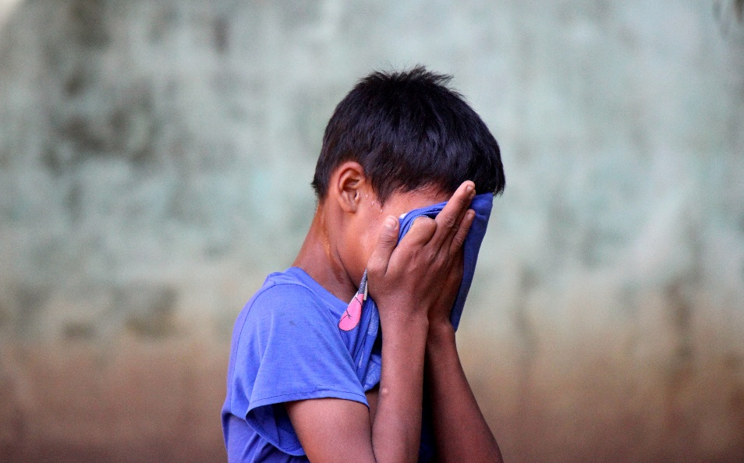
Neglect
Neglect means negligent treatment or maltreatment of a child, including the failure to provide adequate food, medical treatment, supervision, clothing, or shelter.
Citation: Ala. Code § 26-14-1(1)
Physical neglect
Educational neglect
Emotional neglect

Slide 15
Signs to Look for with Neglect
Clothing that is dirty, torn, poorly fitting or inappropriate for the weather
Sleepiness
Poor hygiene
Untreated medical or dental problems
Inappropriate responsibility for younger siblings
Frequent tardiness or absences from school
Apparent lack of supervision

Slide 16
If you suspect abuse, what should you do?
Trust your instincts
Take notes
Look at the facts
Make a report using form:
DHR-FCS-1593 available at your county DHR office or available online.
http://dhr.alabama.gov/services/Child_Protective_Services/WrittenReport_MandatoryReporters.aspx

Slide 17

DHR On-line Mandatory Training
Link under Child Protective Services
  www.dhr.alabama.gov
  Link under CTF web site
    Training opportunities
    www.ctf.alabama.gov

Slide 18
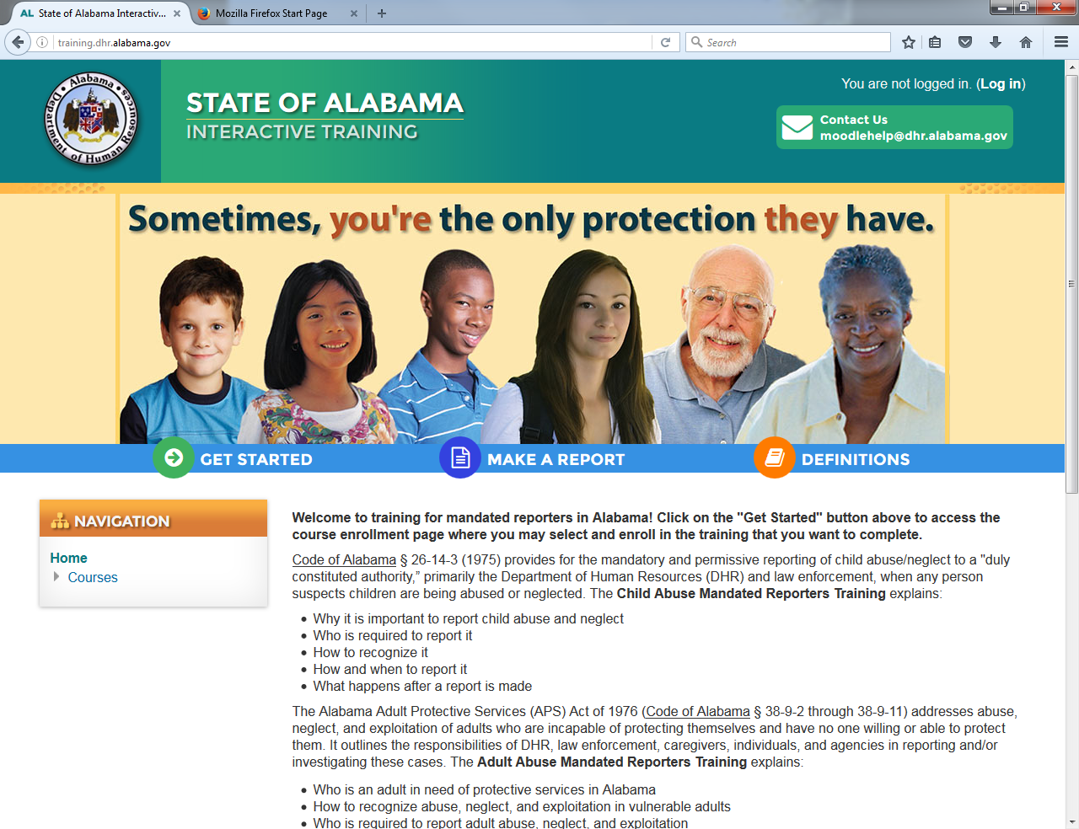

Slide 19

How Common is Child Abuse & Neglect Nationally?*
Notes:
Update

Slide 20
Data are always 2 years in arrears – this report released in February 2023
Number of reports nationally decreased due to continuing pandemic
76% neglect
16% physical abuse
10.1% sexual abuse
.2% sex trafficked
1820 children died from abuse/neglect

Slide 21

The Alabama Story - 2021
36,139 reports made
11,840 victims
43% Neglect
52% Physical Abuse
18% Sexual Abuse
.6% Sex trafficked
36 child deaths reported due to abuse/neglect – increased from previous year
Most indicated abuse victims in Alabama are under the age of four.
2134 victims under the age of one- increase from previous year

Slide 22
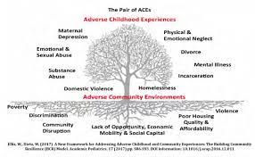

Slide 23
Long term effects of child abuse
Learning disorders or speech deficits
Dropping out of school
Sexually transmitted diseases
Teenage pregnancy
Substance abuse
Unemployment
Crime and violence
Brain damage
Suicide
Depression, anxiety or low self-esteem

Slide 24
What Child Maltreatment Means to Society
Annual cost of child abuse and neglect is $124 Billion nationally
Annual cost to Alabama is over $3.7 Billion*
A child who is abused or neglected is 59% more likely to be arrested as a juvenile than other children
An estimated one-third of abused and neglected children will eventually victimize their own children
*Cost of child maltreatment to the Alabama Economy – released April 2021

Slide 25
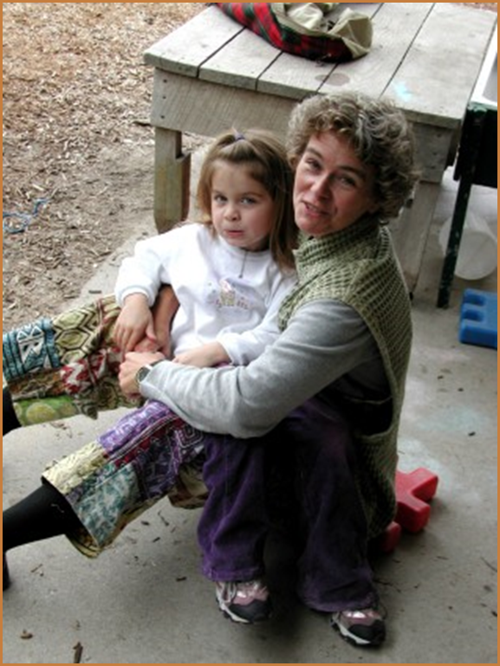
What does Prevention look like?
Core of Strengthening Families™: Building the 5 Protective Factors
  Parental resilience
  Social connections
  Knowledge of parenting and child development
  Concrete support in times of need
  Social and emotional competence of children

Slide 26

Let’s all pull together to ensure children are safe and protected!

Slide 27

Contact Information
Department of Child Abuse and Neglect Prevention
www.ctf.Alabama.gov
Director
Sallye R. Longshore
sallye.longshore@ctf.alabama.gov
Special Projects Manager
Amanda Lightsey
amanda.lightsey@ctf.alabama.gov
Prevent Child Abuse America
www.preventchildabuse.org
National Alliance of Children’s Trust & Prevention Funds
www.ctf.alliance.org

