Slide 1

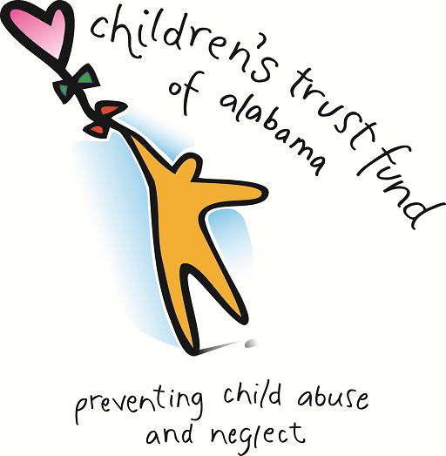

Supporting Families through Bringing the Protective Factors into your Life and Work
Sallye Longshore, Director
Alabama Department of Child Abuse & Neglect Prevention
Children’s Trust Fund
Prevent Child Abuse Alabama

Slide 2
OVERVIEW
Alabama Department of Child Abuse & Neglect Prevention, The Children’s Trust Fund, was established in 1983
We became the Prevent Child Abuse Alabama Chapter in 2007
  Our Mission:
  We secure resources to fund evidenced-based community programs committed to the prevention of child maltreatment. We advocate for children and the strengthening of families.

Slide 3
GRANTEE NETWORK
We currently provide 175 community-based prevention grants:
  17 Home Visiting Programs
  16 Mentoring Programs
  57 Parent Education & Support Programs
  23 Public Awareness & Training Programs
  7 Respite Care Programs
  35 After-school programs/school based and non-school based
  20 Fatherhood Programs
Notes:
We currently award 146 grants from 4 primary federal and state funding streams – CBCAP, CFTF, TANF, and ETF/GF
Research suggests key activities as useful for the prevention of child maltreatment: raising public awareness, providing education and supports for parents – particularly those facing special challenges (low resources of special needs children), facilitating positive father involvement, and promoting youth awareness, knowledge, and skills related to resilience.
Thus the types of programs we fund include: parent education and support, home visiting, fatherhood, respite care, youth-based and mentoring, and community awareness programs
*Note: 127 grants for PY 2019-2020 and currently fund 19 Fatherhood programs via TANF

Slide 4
GRANTEE NETWORK
Program staff of each grantee organization are required to participate in all 7 online courses of Strengthening Families
All programs are encouraged to promote the protective factors in their work with children and families
We award an annual grant to the Alabama Partnership for Children who houses a certified trainer and focuses on engaging early childhood providers and parents of children birth to five

Slide 5
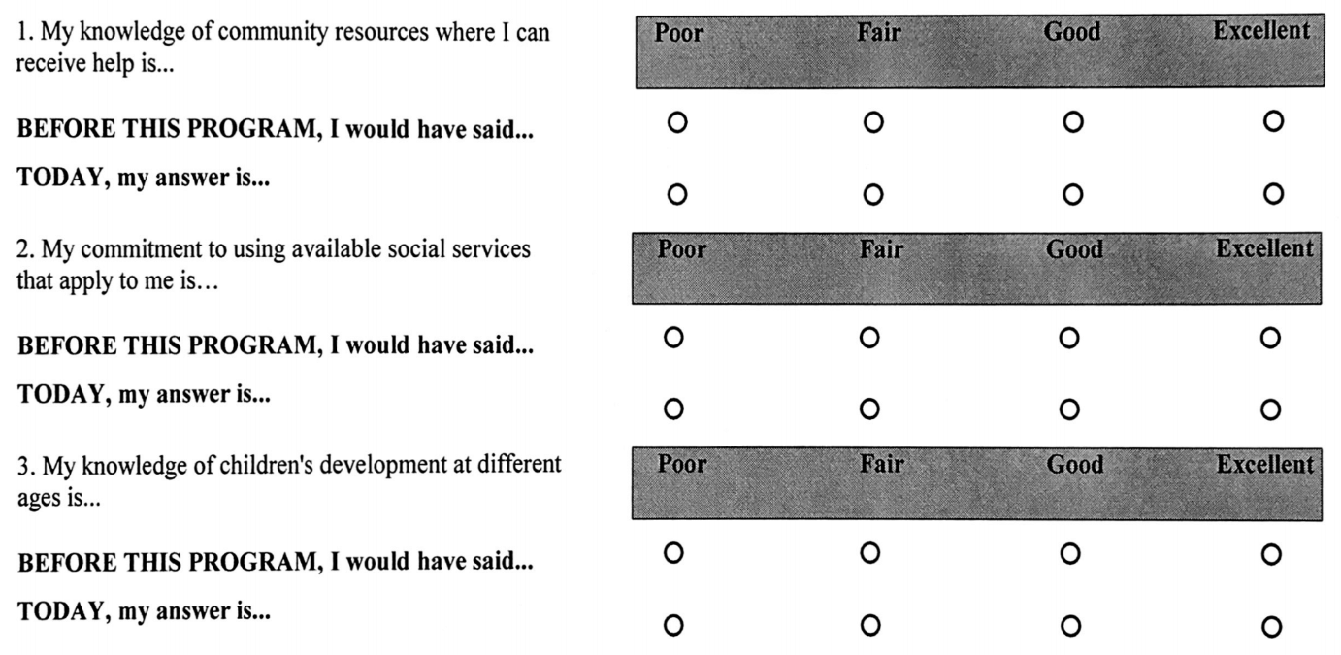
EVALUATION OF GRANTEES
Annual evaluation of our funded programs is based on their efforts to promote the protective factors among families and youth served
Although there’s a variation in program delivery models, all are assessed on common objectives centered on the protective factors

Slide 6
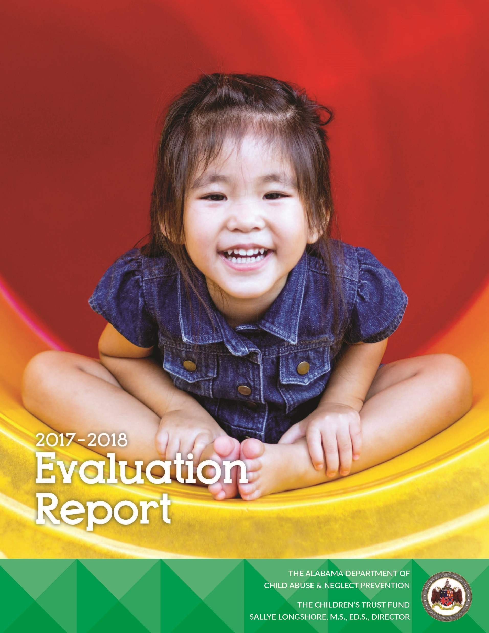
EVALUATION OF GRANTEES
  “Prevention programs funded by ADCANP/CTF have documented important positive effects for parents and youth in Alabama. Support for these programs serves to enhance protective factors and reduce the significant human and economic cost of child abuse and neglect in our state.”
  – Auburn University Human Development & Families Studies

Slide 7
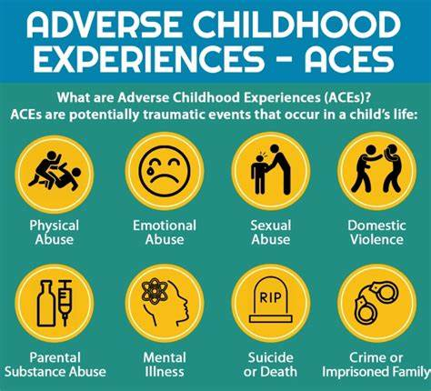
What are ACEs?
Adverse Childhood Experiences (ACEs) – term given to describe all types of abuse, neglect and other traumatic experiences that occur to individuals under the age of 18

Slide 8
ACE Questionnaire
Research shows adverse childhood experiences (ACEs) have a negative impact on a child’s health and well-being later in life. The accumulation of multiple ACEs is associated with a detrimental long-term impact on health and development.

Slide 9
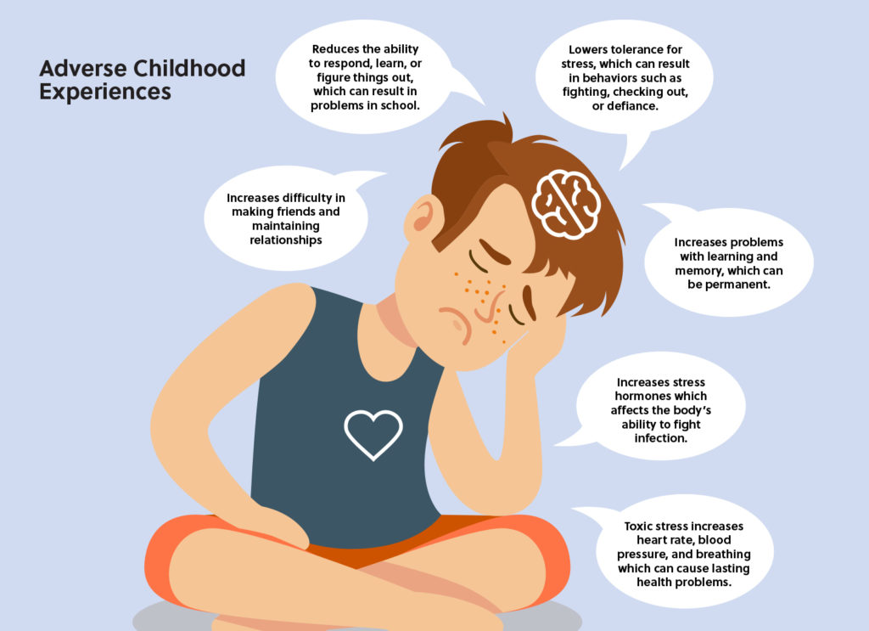

Slide 10
Risk factors
are not
predictive factors
because of
protective factors
Dr. Carl Bell, University of Illinois

Slide 11
What we know:
Families gain what they need to be successful when
key protective factors
are robust in their lives and communities
Notes:
What we knew intuitively and from the research is that families thrive when key protective factors are robust in their lives and communities.
What we also discovered is that fewer than 10% of children 0-5 are reached by any kind of preventive service such as home visiting or parent education.
The research also indicated:
Child abuse and neglect, strong families and optimal child development are outcomes that are tied together.
Risk is not predictive—because of protective factors.
Five specific protective factors are tied to child abuse and neglect, strong families and optimal child development.
You can build these protective factors IN MANY DIFFERENT SETTINGS.
The challenge faced by the developers of Strengthening Families was to find a way to help the many people who see children and their families every day to become part of a significant support system for the families they connect with.
In the end we are interested in protective factors because they are correlated with many of the outcomes that we care about.
CSSP’s original focus was on early care and education programs, where the largest proportion of young children – and their families – go every day. These familiar places are much more likely to match a family’s language, culture and traditions – and have been chosen by the family in the first place. Their hypothesis was that if these places chosen by families could be mobilized to be prevention agents and early warning responders, impact could be had on millions of children. And by focusing on positive outcomes and healthy development, which could engage more families much more easily than prevention programs based on identifying “at risk” families.
Besides the extensive literature reviews and the lengthy discussions with the advisory committee, exemplary programs were sought out to learn what they might already be doing to build protective factors with families. A national survey of all states, individual 27 page surveys with 200 programs, and extended site visits and interviews with 25 programs showed us dramatically that a wide variety of exemplary programs are already building protective factors with families every day. Our most powerful, convincing information about the impact of programs on PARENTS were family members themselves and the community partners who worked closely with these programs.
They also discovered that these early childhood programs along with after school programs, home visiting programs, family resource centers and other places where families already go and feel comfortable, were eager to think with them about what more they could do to reduce stress for the families they serve. Their consistency with the culture and values of the families who come there, their daily contact, and mission of healthy child development make them ideally trusted coaches for all kinds of parents.

Slide 12

Family Protective Factors
Parental resilience
Social connections
Knowledge of parenting and child development
Concrete support in times of need
Social and emotional competence of children
Notes:
Here is a quick review of the protective factors themselves. Remember, these is not a complete list of all the characteristics that can be protective factors in the lives of families. But it is a list of critical ones that we all have the opportunity to influence with the families we work with.

Slide 13
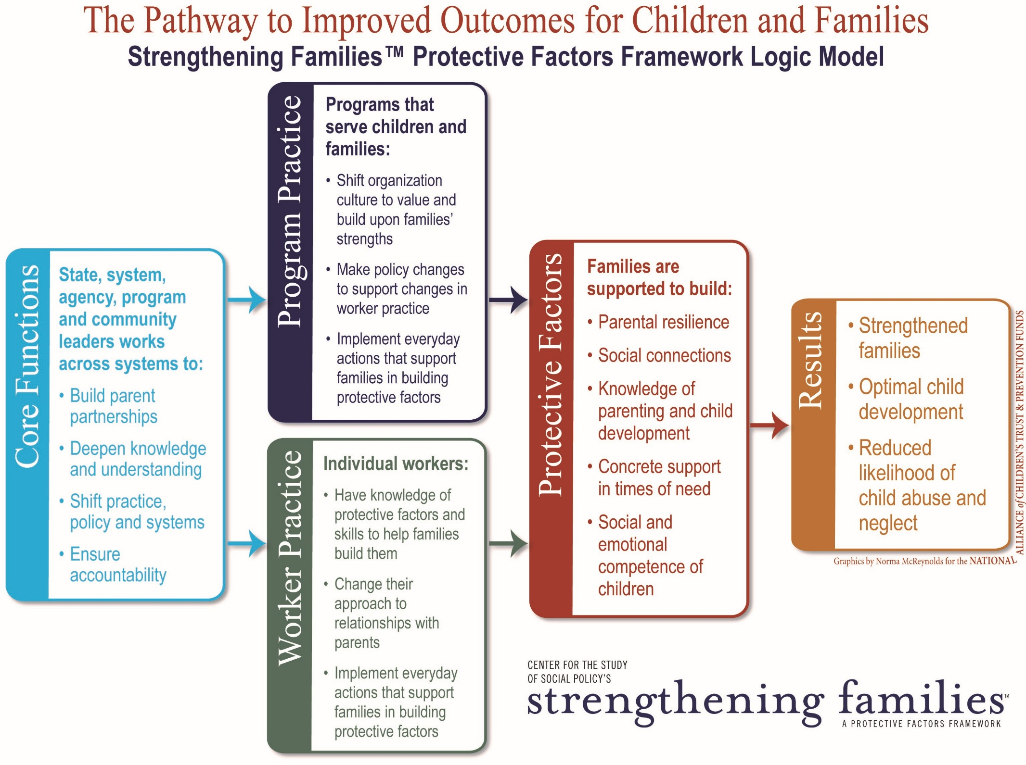

Slide 14
Children don’t grow up in programs…
They grow up in families and in communities.
Dr. Urie Bronfenbrenner, Cornell University

Slide 15

Notes:
Video: Brene Brown “Are You comfortable asking for help?” (not referenced in TM, but coordinates with “Asking for Help” Activity on p. 2)

Slide 16
CHILD WELFARE PARTNERSHIP
We’re currently working to embed the Strengthening Families™ framework within the Alabama Department of Human Resources (DHR) – trained Districts 1, 2, 3, 4, 5 & 7. District 6 was trained in person in March 2020 – just before COVID
This partnership involves our Alabama Network of Family Resource Centers (ANFRC) and their cadre of certified SF trainers.
We hope to continue the training in the future.

Slide 17
STRENGTHENING FAMILIES THROUGH FATHERS
Through funding from DHR, we launched the Strengthening Families through Fathers pilot program in three regions of the state
Involves fathers (and mothers) who are involved in SNAP, child care subsidy program, and child support cases as participants in free program to gain education and employment services, while also training them in the protective factors framework

Slide 18
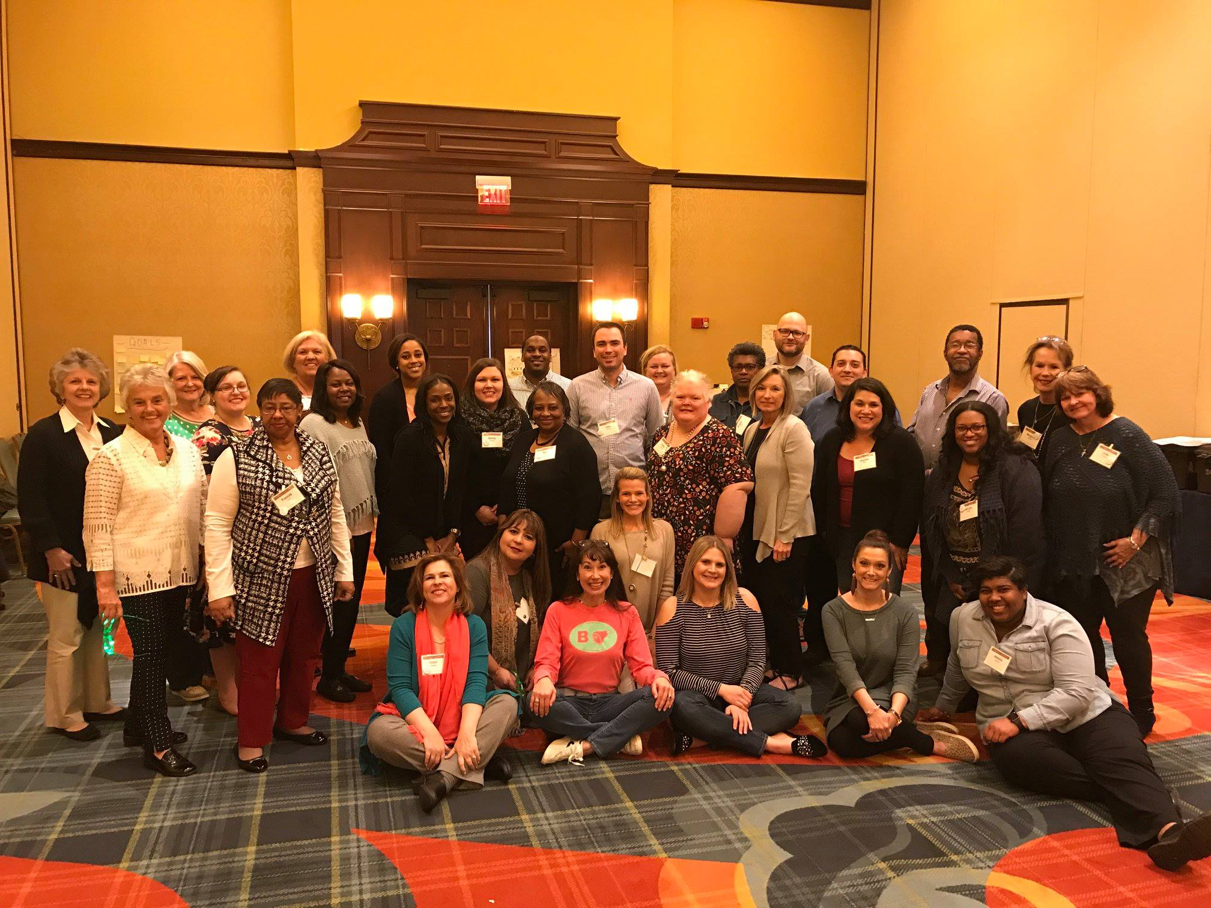
NETWORK OF FAMILY RESOURCE CENTERS
In 2018, we sponsored the National Alliance’s training to certify our Department’s staff along with staff of each Family Resource Center in our state
This increased the number of certified trainers in Alabama from 3 to 33

Slide 19
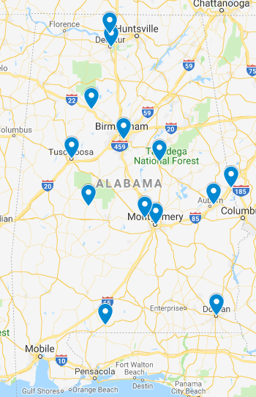
NETWORK OF FAMILY RESOURCE CENTERS
Provides a regional approach to expanding and embedding the framework statewide
Monthly calls with all certified trainers provides consistent communication to support one another’s outreach and training efforts

Slide 20
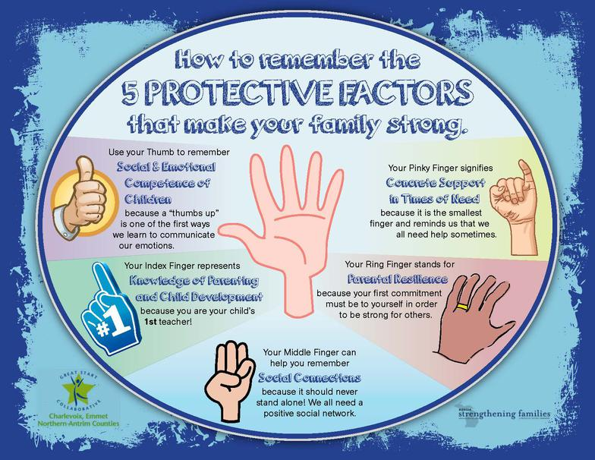

Slide 21
CONTACT
Sallye Longshore, Director
Sallye.Longshore@ctf.alabama.gov
www.ctf.alabama.gov

